Slide 1
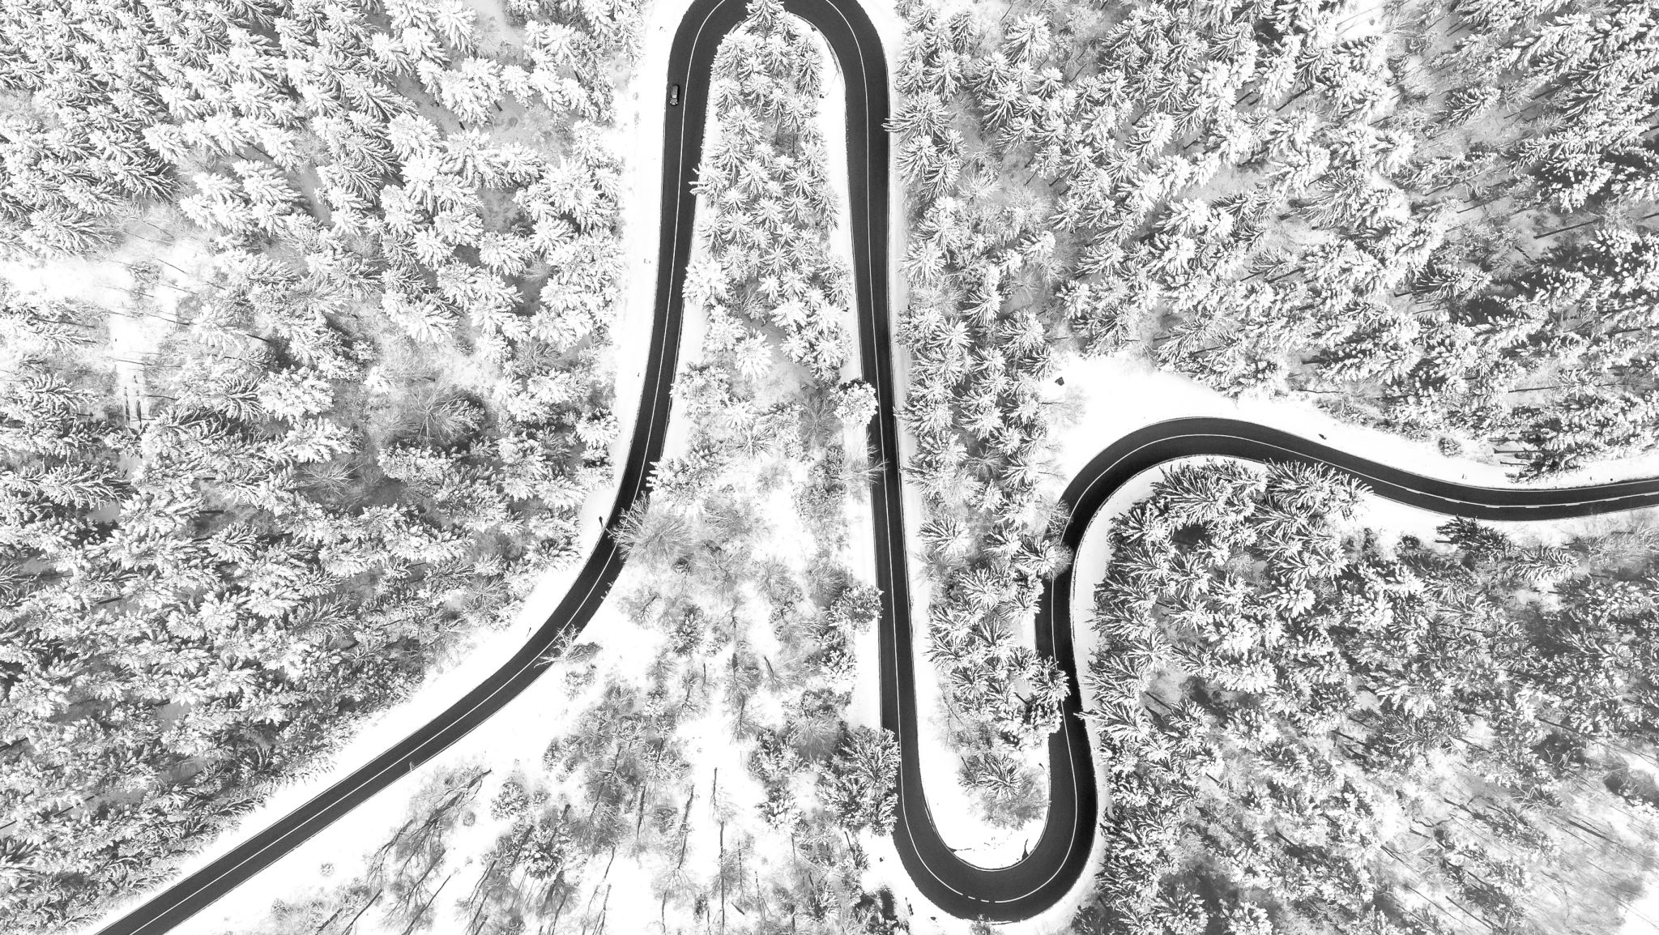
Real-Time Semantic Segmentation for Autonomous Driving
Peeyush Dyavarashetty
Rekha Srinivas Chimpiri
Abdul Hannan
Srijinesh Alanka

Slide 2

Problem Statement: Semantic Segmentation
Assign each pixel into a single class
Importance :
Segmentation of visual input is critical
Challenges:
Accuracy
Efficiency
Impact:
Lane detection
Pedestrian recognition
Traffic sign identification
Vehicle safety and reliability
Obstacle detection
Environment perception

Slide 3
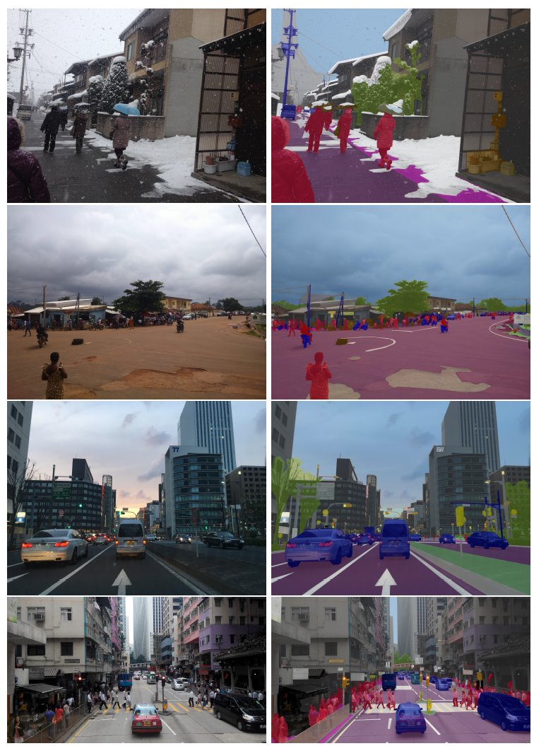
Mapillary Dataset
Total Images: 25000
Training: 18000 images
Validation: 2000 images
Test: 5000 images
Coverage: 6 continents
70 classes, 124 semantic object categories
Image Resolution: Photos captured from various devices with differing resolutions

Slide 4
Deep Learning models used
YOLO
Fast-SCNN
PPLite-Seg
STDC-Seg
DDRNet
BiSeNet
PPLite B50
PPLite T50

Slide 5

Loss functions, Optimizers and Metrics
Focal loss
Cross Entropy
Cross Entropy with weights
Jaccard loss
Dice Loss
Adam
SGD
mIoU
FPS

Slide 6
Fast-SCNN
Loss Function | Optimizer | Ep | mIoU | Avg time
Cross Entropy | Adam | 60 | 0.219 | 0.006267594
CE with weights | Adam | 60 | 0.214 | 0.006272004
Focal loss gamma = 3 | Adam | 25 | 0.196 | 0.006197016
CE with polynomial LR | SGD + Momentum | 52 | 0.216 | 0.006197016
Per epoch train time
Focal loss: 4.5hrs
Cross Entropy: 1hr
Faster but less accurate than BiSeNet
Polynomial LR is based on research paper
60 epochs
Power = 0.9
Initial lr = 0.045
Momentum = 0.9
Batch size = 4

Slide 7
BiSeNet
Loss Function | Optimizer | Ep | mIoU | Avg time
CE with weights | Adam | 60 | 0.226 | 0.010200358
Focal loss gamma = 2 | Adam | 15 | 0.225 | 0.005276626
CE with polynomial LR | SGD + Momentum | 52 | 0.247 | 0.005859865
Per epoch train time
Focal loss: 4.5hr
Cross Entropy loss: 1hr
Slower but more accurate than FastSCNN
Polynomial LR based on research paper
60 epochs
Power = 0.9
Initial lr = 2.5e⁻²
Momentum = 0.9
Weight decay = 1e⁻⁴
Batch size = 2

Slide 8
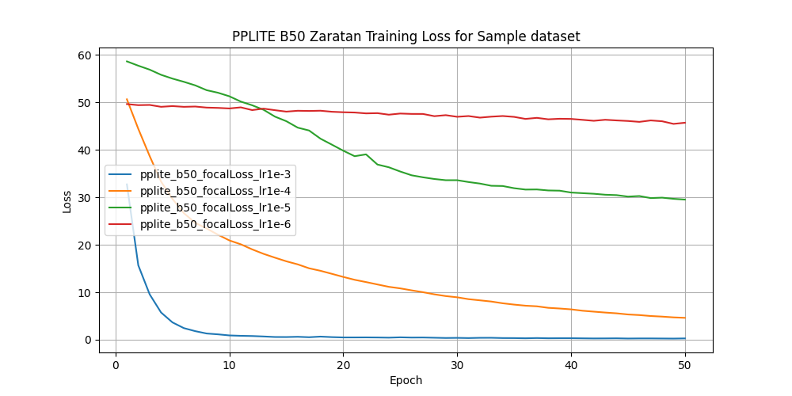
PPLite B50
1e-3 best on sample dataset
Trained using focal loss and Adam optimizer
Used 4 GPUs
Training time: 10hr / epoch
After 2 epochs
Train loss: 0.3343
Validation loss: 0.3028

Slide 9
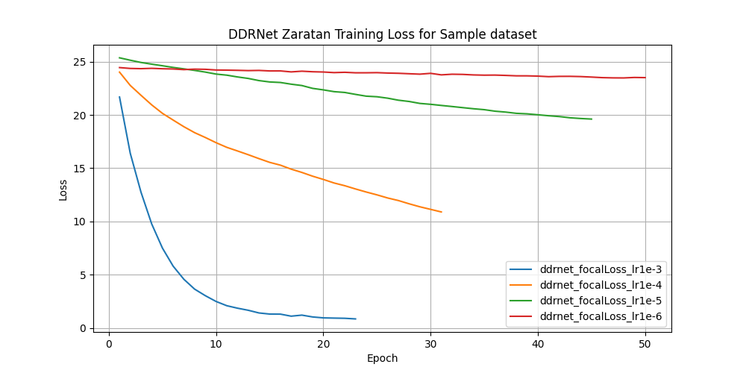
DDRNet23Slim
1e-3 best on sample dataset
Trained using focal loss and Adam optimizer
Used 4 GPUs
Used 5hrs but only 23 epochs trained for lr = 1e-3
Discarded since slow as sample dataset

Slide 10
Other networks
STDC-Seg
PPLite T50
Trained with lr = 1e⁻³
Training time: 6.5hr/epoch
Used 4 GPUs
Trained until 3 epochs
Used Adam optimizer
Dice, CE and edge loss
Training loss: 1.779
Validation: 1.6656
Trained with lr=1e-3
Training time: 9.5hr/epoch
Used 4 GPUs
Trained until 3 epochs
Used Adam optimizer
Focal loss
Training loss: 0.3506
Validation loss: 0.2794

Slide 11
Testing
Video: 30 fps and 20s
Tested on Nvidia RTX 4070 mobile 8GB 140W
Fast-SCNN Model | Model time | Total time
Cross Entropy (CE) | 3.444 | 29.82
CE with weights | 3.252 | 35.376
Focal loss gamma = 3 | 3.058 | 34.458
CE with polynomial LR | 3.123 | 31.92
BiSeNet Model | Model time | Total time
CE with weights | 2.358 | 81.94
Focal loss gamma = 2 | 3.475 | 81.012
CE with polynomial LR | 1.836 | 81.934

Slide 12
Conclusion
Most accurate: BiSeNet model with Cross Entropy Loss and polynomial learning rate (mIoU: 0.247)
Most efficient: Fast-SCNN model with Cross Entropy loss (mIoU: 0.219)
Higher speed than BiSeNet
Highest in Fast-SCNN
Loss function and learning rate schedule significantly impacts both model efficiency and overall training duration
Focal loss is complex and affects training
Cross Entropy loss is simple

Slide 13
Future works
Try pruning bigger models
1
Try SegBlocks model (mIoU: 0.4) in Mapillary vistas dataset
2
Update LinkNet
3
Learn multinode and multiGPU for faster training
4
Understand more real-time architectures and implement them
5
Make present code faster to have real-time
6

Slide 14
References
DR. P. K. Poudel, S. Liwicki, and R. Cipolla, “Fast-scnn: Fast semantic segmentation network,” 2019. [Online]. Available: https://arxiv.org/abs/1902.04502
C. Yu, J. Wang, C. Peng, C. Gao, G. Yu, and N. Sang, “Bisenet: Bilateral segmentation network for real-time semantic segmentation,” 2018. [Online]. Available: https://arxiv.org/abs/1808.00897
J. Peng, Y. Liu, S. Tang, Y. Hao, L. Chu, G. Chen, Z. Wu, Z. Chen, Z. Yu, Y. Du, Q. Dang, B. Lai, Q. Liu, X. Hu, D. Yu, and Y. Ma, “Pp-liteseg: A superior real-time semantic segmentation model,” 2022. [Online]. Available: https://arxiv.org/abs/2204.02681
G. Neuhold, T. Ollmann, S. R. Bulo, and P. Kontschieder, “The mapillary vistas dataset for semantic understanding of street scenes,” in 2017 IEEE International Conference on Computer Vision (ICCV), 2017, pp. 5000–5009
I. Papadeas, L. Tsochatzidis, A. Amanatiadis, and I. Pratikakis, “Real-time semantic image segmentation with deep learning for autonomous driving: A survey,” Applied Sciences, vol. 11, no. 19, 2021. [Online]. Available: https://www.mdpi.com/2076-3417/11/19/8802

Slide 15
Thank You

